Slide 1
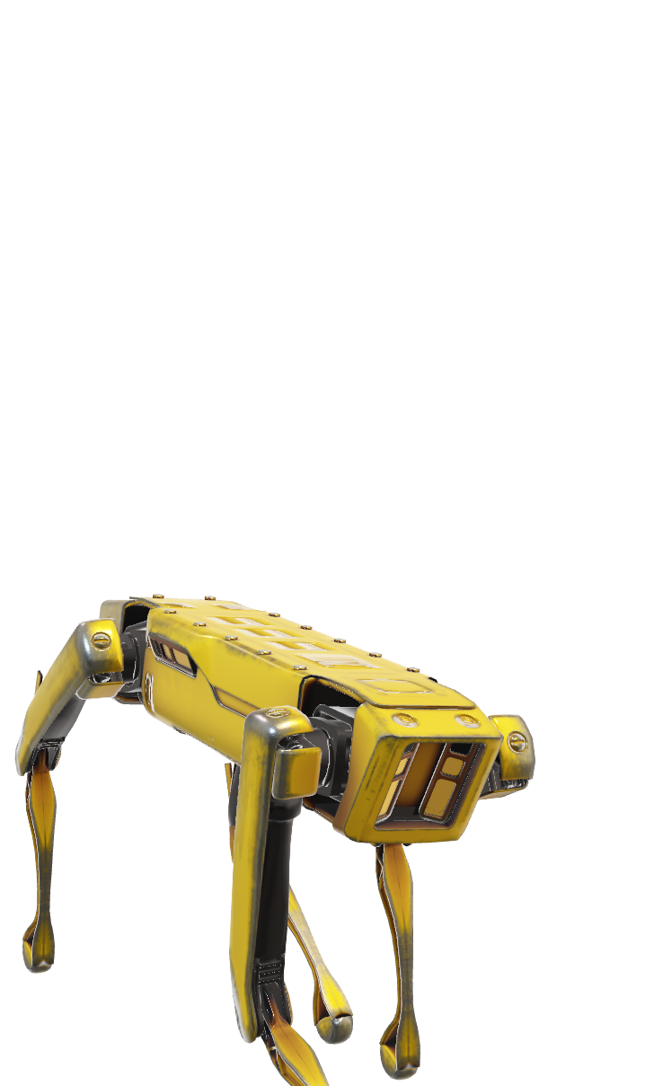
Teaching a robot dog new tricks
Vision and Audio
Guillaume Krafft

Slide 2
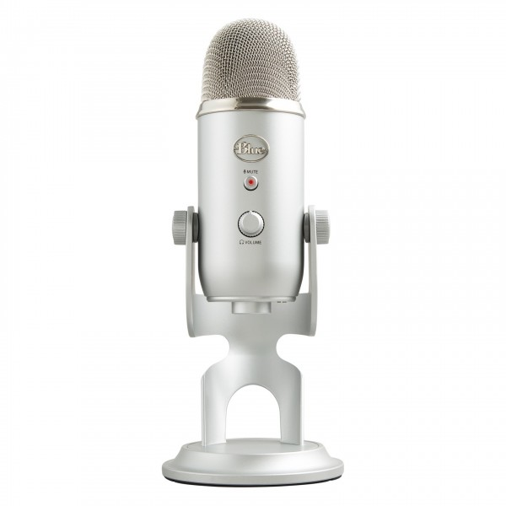
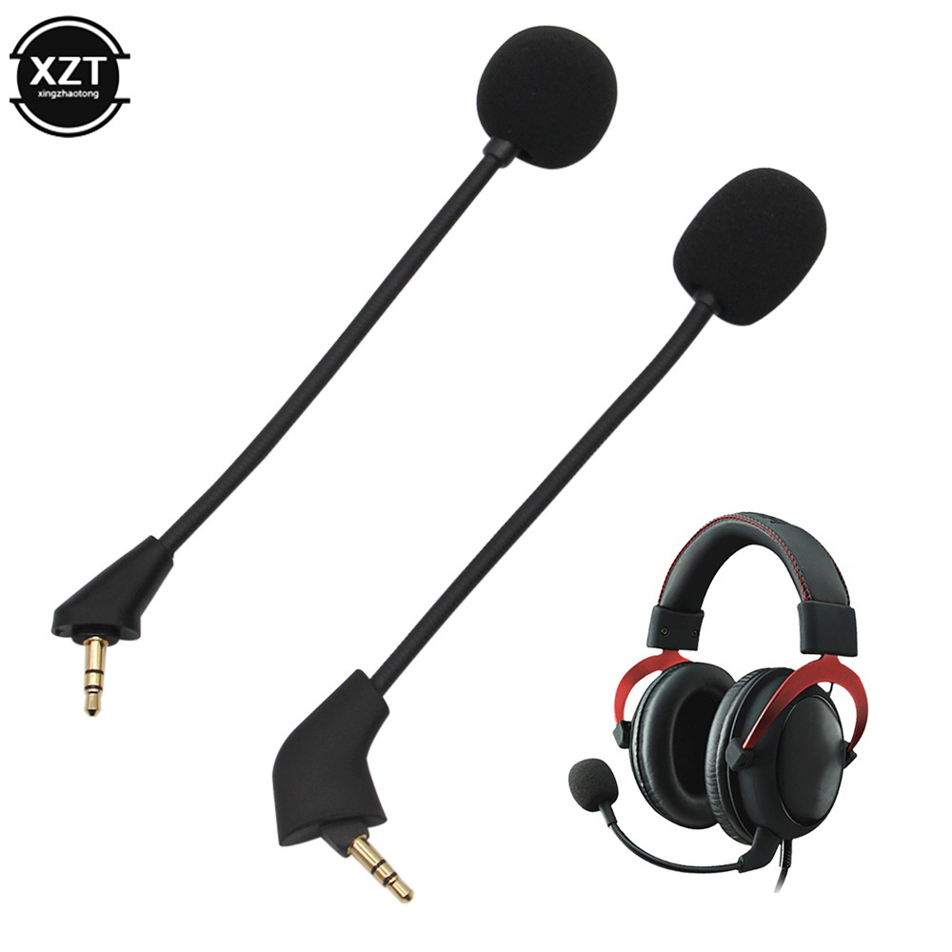
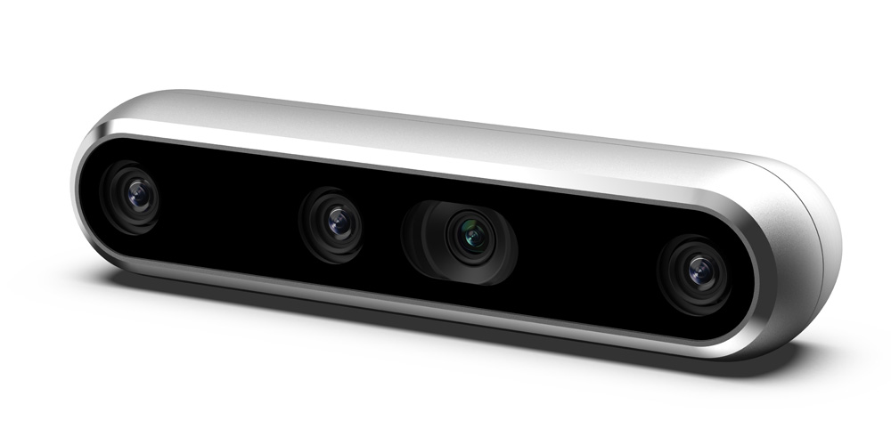
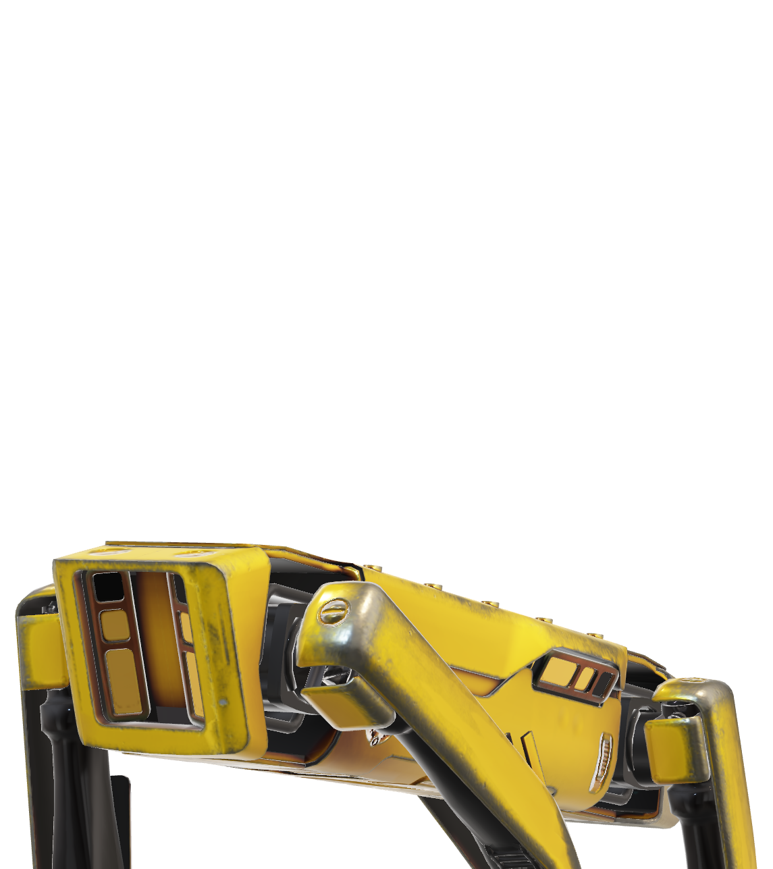
Goal of the project
Convey information from the human to the robot using both video and audio feedback
First start with video and audio separately
Video : Intel RealSense D455
Audio : to be defined
Notes:
This is not the robot we will be using for the project but this was the only free model online, and I think it makes for cool animations

Slide 3
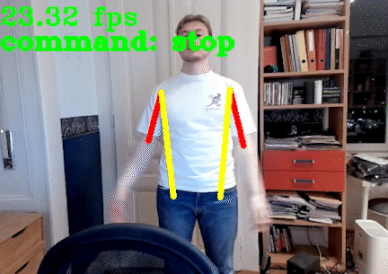
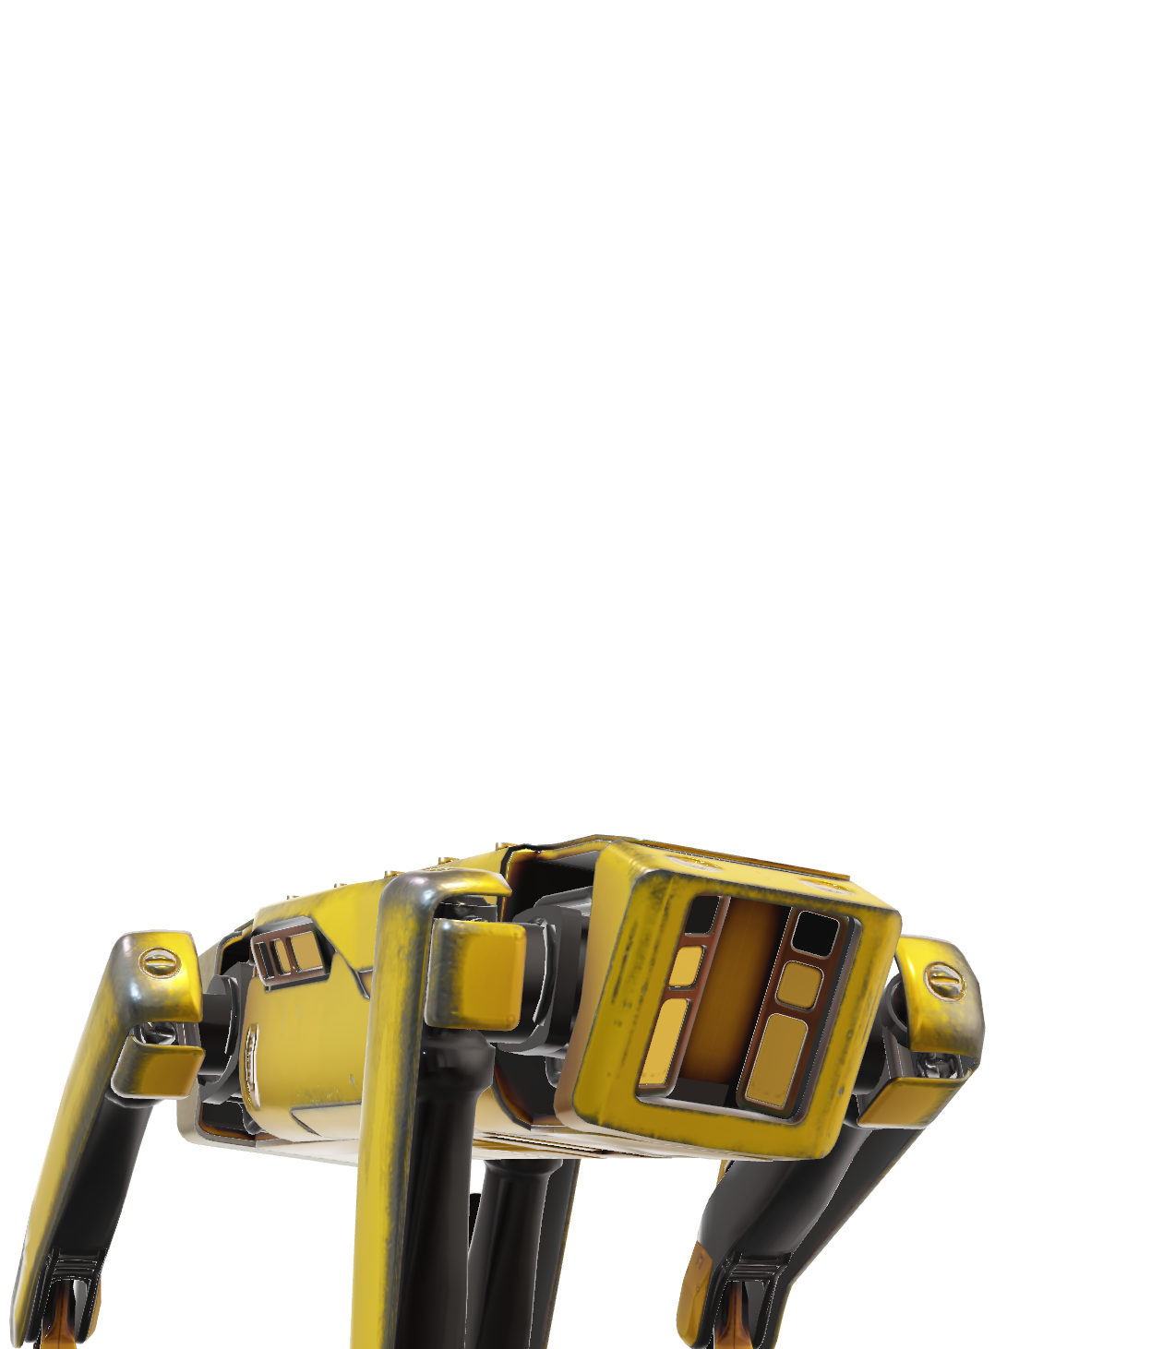
Goal of the project
In a second time : bring audio and video together
Integrate these methods with Yucef’s work
Bring everything to the actual robot
Make a nice demo !
Notes:
A sneak peek of the work that has already been done

